Slide 1

Transforming Waste to Warmth
Sustainable solutions Through recycling Tannery Waste buffing dust for structural thermal insulation panels

Slide 2
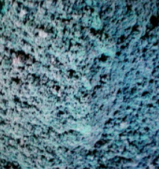
What is buffing dust?
Buffing dust from tannery refers to the fine particles and residues generated during the buffing or sanding process in leather tanneries. Proper disposal and management of tannery buffing dust are important considerations to minimize environmental impact and ensure compliance with regulations.

Slide 3
Only 20% raw material is converted into final product in leather industry . Using buffing dust will help to reduce the large amount of waste production.
Incineration & landfills are mainly used to dispose solid tannery waste which produces oxides of nitrogen & Sulphur. Reducing this waste will decrease the negative effect on living beings.
Recycling buffing dust will aid in preventing soil and water pollution due to the leaching of hazardous chemicals.
Why recycle buffing dust?

Slide 4
Buffing dust to thermal insulator panels :
Buffing dust produced in the tanneries has a lot potential to be reused in multiple industries – from energy generation to building bricks many scopes exist. But there are some key properties of buffing dust that influenced us to take on building thermal insulator panels from it.
Key properties
Buffing dust-Thermal insulator panel
Low thermal conductivity of Buffing dust – Better insulator
Higher water absorption – 7.5%
Good compression Strength
Thermally stable from approx. 200-400 degree

Slide 5
Comparison to existing insulator
Cost
Buffing dust insulator < Existing insulator
Thermal conductivity
Buffing dust insulator < Existing insulator
The lower the conductivity, the higher the insulation
Water absorption
Buffing dust insulator(7.5%) > Existing insulator (5%)

Slide 6
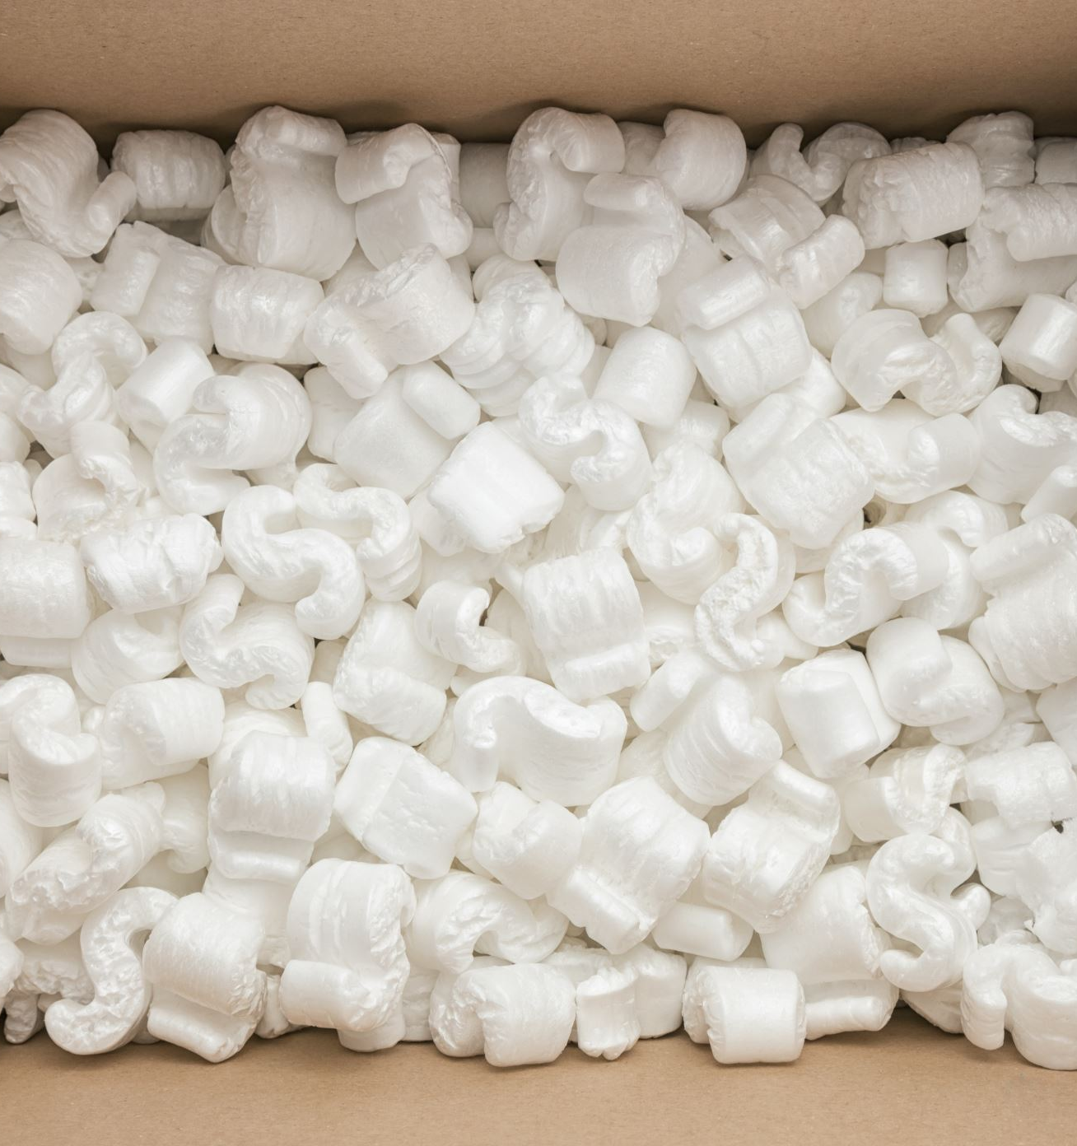
Materials:
Buffing dust from tanneries
Commercially expanded Polystyrene(C8H8)
Blowing agents - Azodicarbonamide

Slide 7
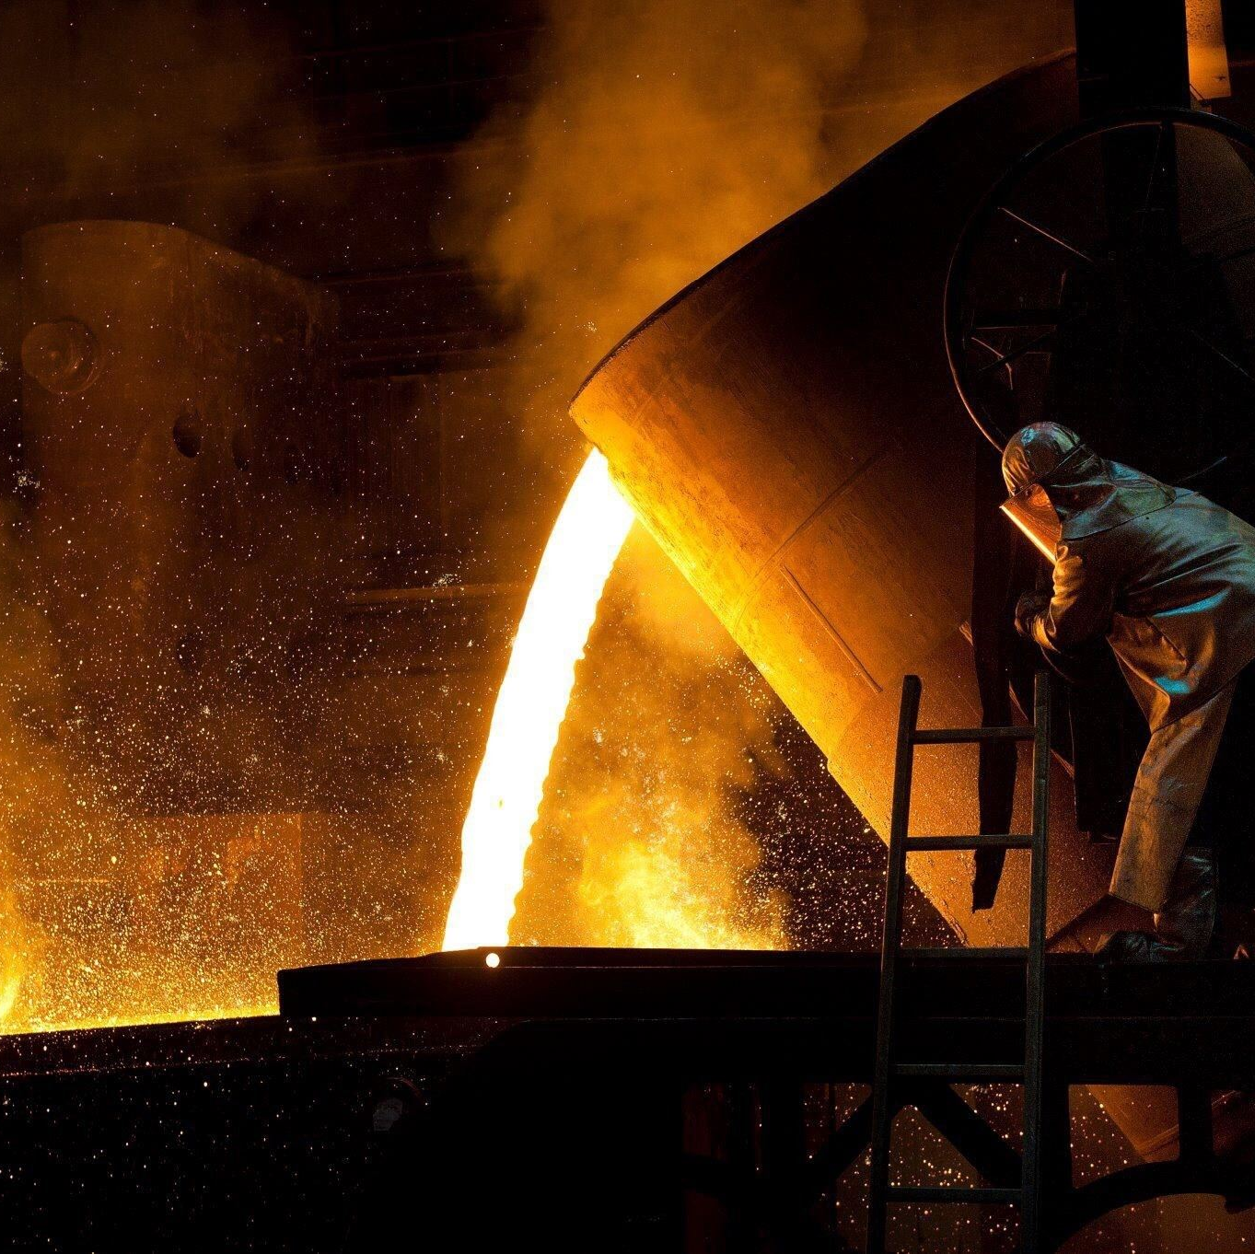
Method:
Polymerization of polystyrene with buffing dust
Mixing the ingredients in high temperature(200-degree celcius) presence of blowing agent
Pouring the molten composite into steel molds
After cooling- samples ready to use

